Slide 1

FEASIBILITY ANALYSIS
LECTURE THREE
Charlotte Adjanor-Doku, PhD
Department of Human Resource & Organisational Development
KNUST School of Business
cadjanor-doku@knust.edu.gh

Slide 2
Lecture Objectives
Explain what a feasibility analysis is and why it’s important.
Describe a product/service feasibility analysis, explain its purpose, and discuss the two primary issues that a proposed business should consider in this area.
Describe an industry/market feasibility analysis, explain its purpose, and discuss the two primary issues to consider when completing this analysis.

Slide 3
Lecture Objectives
Explain what an organizational feasibility analysis is and its purpose and discuss the two primary issues to consider when completing this analysis.
Describe what a financial feasibility analysis is, explain its importance, and discuss the most critical issues to consider when completing this analysis.
Describe a feasibility analysis template and explain when it is important for entrepreneurs to use this template.

Slide 4
What Is Feasibility Analysis?
Feasibility analysis is the
process of determining whether a business idea is viable.
It is the preliminary evaluation
of a business idea, conducted
for the purpose of determining
whether the idea is worth
pursuing.
Feasibility Analysis

Slide 5
When To Conduct a Feasibility Analysis
Timing of Feasibility Analysis
The proper time to conduct a feasibility analysis is early in thinking through the prospects for a new business.
The thought is to screen ideas before a lot of resources are spent on them.
Components of a Properly Conducted Feasibility Analysis
A properly conducted feasibility analysis includes four separate components, as discussed in the following slides.

Slide 6
Feasibility Analysis
Role of feasibility analysis in developing business ideas.

Slide 7
Forms of Feasibility Analysis
Product/Service
Feasibility
Industry/Target
Market
Feasibility
Organizational
Feasibility
Financial
Feasibility

Slide 8
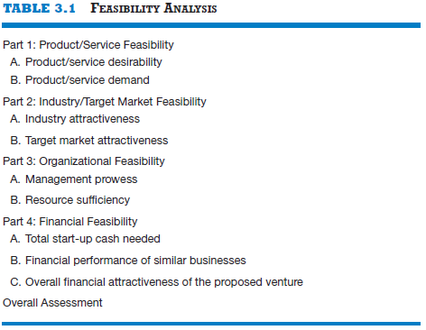
Outline for a Comprehensive Feasibility Analysis

Slide 9
Product/Service Feasibility Analysis
Purpose
Is an assessment of the overall
appeal of the product or service
being proposed.
Before a prospective firm rushes a new product or service into development, it should be sure that the product or service is what prospective customer want.
Product/Service
Feasibility Analysis

Slide 10
Product/Service Feasibility Analysis
Components of product/service
feasibility analysis
Product/Service
Desirability
Product/Service
Demand

Slide 11
Product/Service Desirability
First, ask the following questions to determine the basic appeal of the product or service.
Does it make sense? Is it reasonable? Is it something consumers will get excited about?
Does it take advantage of an environmental trend, solve a problem, or take advantage of a gap in the marketplace?
Is this a good time to introduce the product or service to the market?
Are there any fatal flaws in the product or service’s basic design or concept?

Slide 12
Product/Service Desirability
Second, Administer a Concept Test
A concept statement should be developed.
A concept statement is a one-page description of a business that is distributed to people who are asked to provide feedback on the potential of the business idea.
The feedback will hopefully provide the entrepreneur:
A sense of the viability of the product or service idea.
Suggestions for how the idea can be strengthened or “tweaked” before proceeding further.

Slide 13
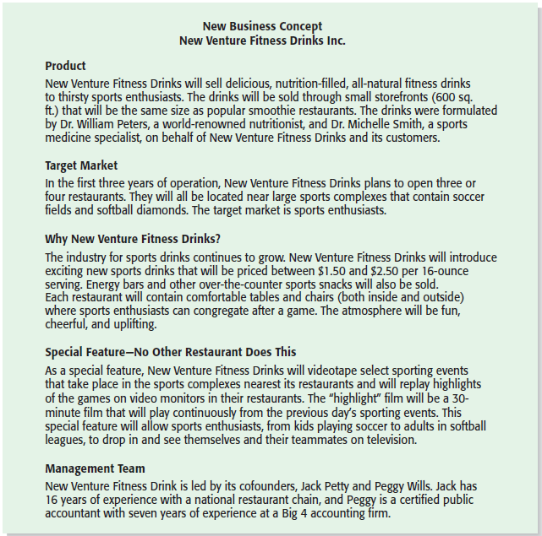
Product/Service Desirability
New Venture Fitness Drink’s Concept Statement

Slide 14
Product/Service Demand 1 of 4
Product/Service Demand
There are two steps to assessing product/service demand.
Step 1: Talking Face-to-Face with Potential Customers.
Step 2: Using Online Tools, Such as Google AdWords and Landing Pages, to Assess Demand.

Slide 15
Product/Service Demand 2 of 4
Talking Face-to-Face with Potential Customers
The only way to know if your product or service is what people want is by talking to them.
The idea is to gauge customer reaction to the general concept of what you want to sell, and tweak, revise, and improve on the idea based on the feedback.
In some cases, talking with potential customers will cause an entrepreneur to abandon an idea.
Entrepreneurs are often surprised to find that a product idea they think solves a problem gets lukewarm reception when they talk to actual customers.

Slide 16
Product/Service Demand 3 of 4
Utilizing Online Tools, Such as Google AdWords and Landing Pages, to Assess Demand
The second way to assess demand is to utilize online tools to gauge reaction from potential customers.
Some entrepreneurs purchase text ads on search engines that show up when a user is searching for a product that is close to their idea. If the searcher clicks on the text ad, they are directed to a landing page that describes the idea. There may be a link on the landing page that says “For future updates please enter your e-mail address.” Demand for the idea can be assessed by how many people click on the text ad and enter their e-mail address.

Slide 17
Product/Service Demand 4 of 4
Utilizing Online Tools, Such as Google AdWords and Landing Pages, to Assess Demand (continued)
A variety of additional online tools are available to help assess the demand for a new product or service.
Examples include:
Sites that provide feedback on business ideas (Foundersuite, Quirky).
Market Research (CrowdPicker, Google Trends).
Online Surveys (Survey Monkey, Google Consumer Surveys).
Q&A Sites (Quora, Stack Overflow).

Slide 18
Industry/Target Market Feasibility Analysis 1 of 2
Purpose
Is an assessment of the overall
appeal of the industry and the
target market for the proposed
business.
An industry is a group of firms
producing a similar product or
service.
A firm’s target market is the
limited portion of the industry it
plans to go after.
Industry/Target
Market Feasibility Analysis

Slide 19
Industry/Target Market Feasibility Analysis 2 of 2
Components of industry/target market
feasibility analysis
Industry
Attractiveness
Target Market
Attractiveness

Slide 20
Industry Attractiveness 1 of 2
Industry Attractiveness
Industries vary in terms of their overall attractiveness.
In general, the most attractive industries have the characteristics depicted on the next slide.
Particularly important—the degree to which environmental and business trends are moving in favor rather than against the industry.

Slide 21
Industry Attractiveness 2 of 2
Characteristics of Attractive Industries
Are young rather than old.
Are early rather than late in their life cycle.
Are fragmented rather than concentrated.
Are growing rather than shrinking.
Are selling products and services that customers “must have” rather than “want to have.”
Have high rather than low operating margins.
Are not highly dependent on the historically low price of key raw materials.

Slide 22
Target Market Attractiveness
Target Market Attractiveness
The challenge in identifying an attractive target market is to find a market that’s large enough for the proposed business but is yet small enough to avoid attracting larger competitors.
Assessing the attractiveness of a target market is tougher than assessing the attractiveness of an entire industry.
Often, considerable ingenuity must be employed to find information to assess the attractiveness of a specific target market.

Slide 23
How to Define an Attractive Market or market Segment
Competitors:
Look at your competitor analysis. Are you better than the competition? Is the competition getting better or worse at meeting the needs of customers in this segment?
Company resources:
Do you have the right product/service concept to compete in this segment? Do your product/service concept have weaknesses that need to be improved and are they fixable?. Is it consistent with serving this segment?

Slide 24
How to Define an Attractive Market or market Segment
Segment size:
The sales potential of the segment, in terms of number of units of your product that can be sold or number of customers served, is important in making a segment attractive
Segment growth rate:
To reduce the risk of losing money when entering a new market, find one that’s growing, not shrinking. Ideally, you should create a market strategy that allows you to serve a market for a good length of time, recouping marketing expenses and any product or service modifications.

Slide 25
How to Define an Attractive Market or market Segment
Segment profitability:
You need to know whether focusing on this customer group is feasible. A segment’s profitability is important in making a segment attractive.

Slide 26
Organizational Feasibility Analysis 1 of 2
Purpose
Is conducted to determine
whether a proposed business has
sufficient management expertise,
organizational competence, and
resources to successfully launch
a business.
Focuses on non-financial resources.
Organizational
Feasibility Analysis

Slide 27
Organizational Feasibility Analysis 2 of 2
Components of organizational
feasibility analysis
Management
Prowess
Resource
Sufficiency

Slide 28
Management Prowess
Management Prowess
A proposed business should candidly evaluate the prowess or ability of its management team to satisfy itself that management has the requisite passion and expertise to launch the venture.
Two of the most important factors in this area are:
The passion that the sole entrepreneur or the founding team has for the business idea.
The extent to which the sole entrepreneur or the founding team understands the markets in which the firm will participate.

Slide 29
Resource Sufficiency 1 of 2
Resource Sufficiency
This pertains to an assessment of whether an entrepreneur has sufficient resources to launch the proposed venture.
To test resource sufficiency, a firm should list the 6 to 12 most critical non-financial resources that will be needed to move the business idea forward successfully.
If critical resources are not available in certain areas, it may be impractical to proceed with the business idea.

Slide 30
Resource Sufficiency 2 of 2
Examples of nonfinancial resources that may be critical to the successful launch of a new business
Affordable office space.
Lab space, manufacturing space, or space to launch a service business.
Availability of contract manufacturers or service providers.
Key management employees (now and in the future).
Key support personnel (now and in the future).
Ability to obtain intellectual property protection.
Ability to form favorable business partnerships.

Slide 31
Financial Feasibility Analysis 1 of 2
Purpose
Is the final component of a comprehensive feasibility analysis.
A preliminary financial assessment is sufficient.
Financial
Feasibility Analysis

Slide 32
Financial Feasibility Analysis 2 of 2
Components of financial
feasibility analysis
Total Start-Up Cash
Needed
Financial Performance
of
Similar Businesses
Overall Financial
Attractiveness of the
Proposed Venture

Slide 33
Total Start-Up Cash Needed
Total Start-Up Cash Needed
The first issue refers to the total cash needed to prepare the business to make its first sale.
An actual budget should be prepared that lists all the anticipated capital purchases and operating expenses needed to generate the first Ghc1 in revenue.
The point of this exercise is to determine if the proposed venture is realistic given the total start-up cash needed.

Slide 34
Financial Performance of Similar Businesses
Financial Performance of Similar Businesses
Estimate the proposed start-up’s financial performance by comparing it to similar, already established businesses.
There are several ways to doing this, all of which involve a little ethical detective work.
First, there are many reports available, some for free and some that require a fee, offering detailed industry trend analysis and reports on thousands of individual firms.
Second, simple observational research may be needed. For example, the owners of New Venture Fitness Drinks could estimate their sales by tracking the number of people who patronize similar restaurants and estimating the average amount each customer spends.

Slide 35
Overall Financial Attractiveness of the Proposed Venture 1 of 2
Overall Financial Attractiveness of the Proposed Investment
A number of other financial factors are associated with promising business start-ups.
In the feasibility analysis stage, the extent to which a business opportunity is positive relative to each factor is based on an estimate rather than actual performance.
The table on the next slide lists the factors that pertain to the overall attractiveness of the financial feasibility of the business idea.

Slide 36
Overall Financial Attractiveness of the Proposed Venture 2 of 2
Financial Factors Associated With Promising Business Opportunities
Steady and rapid growth in sales during the first 5 to 7 years in a clearly
defined market niche.
High percentage of recurring revenue - meaning that once a firm wins a
client, the client will provide recurring sources of revenue.
Ability to forecast income and expenses with a reasonable degree of certainty.
Internally generated funds to finance and sustain growth.
Availability of an exit opportunity for investors to convert equity to cash.

Slide 37

ANY QUESTION?

Slide 38
THANK YOU

